Slide 1



METROLOGY EQUIPMENT / MEASUREMENT SERVICES / CLOUD

Slide 2

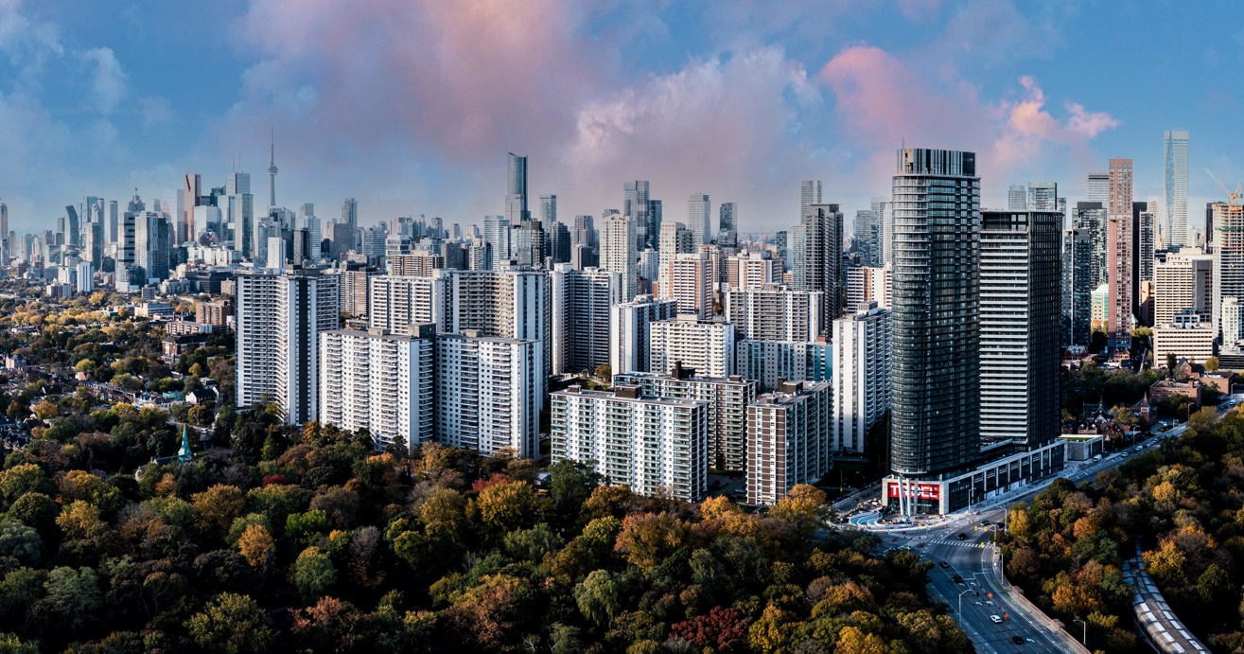
MEASUREMENT TOOLS FOR EVERYTHING YOU DO
Our customers know that HAKARI™ premium services and equipment are the best choice to improve overall measurement performance, productivity, and assets and infrastructure monitoring.
HAKARI is always the right choice.

Slide 3
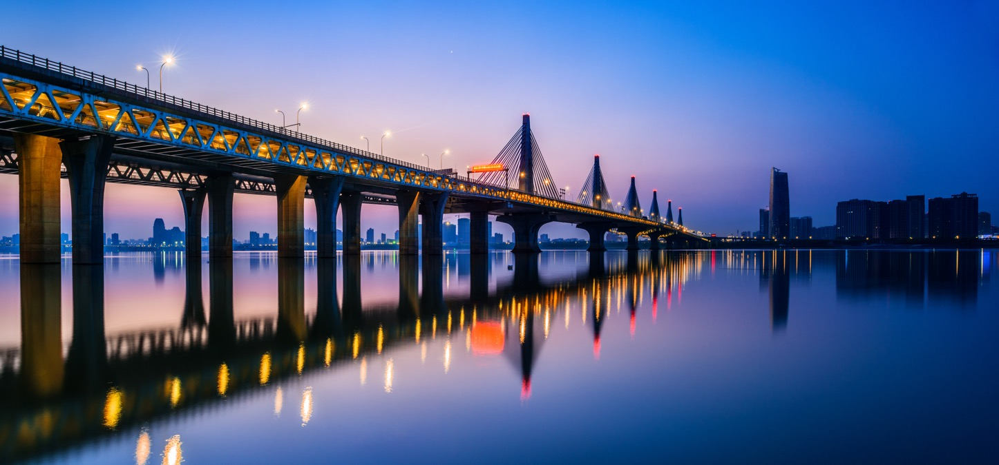
METROLOGY SOLUTIONS THAT EMPOWER YOU
We operate with the mission to provide the best risk management hardware and software for critical infrastructure and precision metrology.
We provide cutting-edge technology and support for your project.

Slide 4
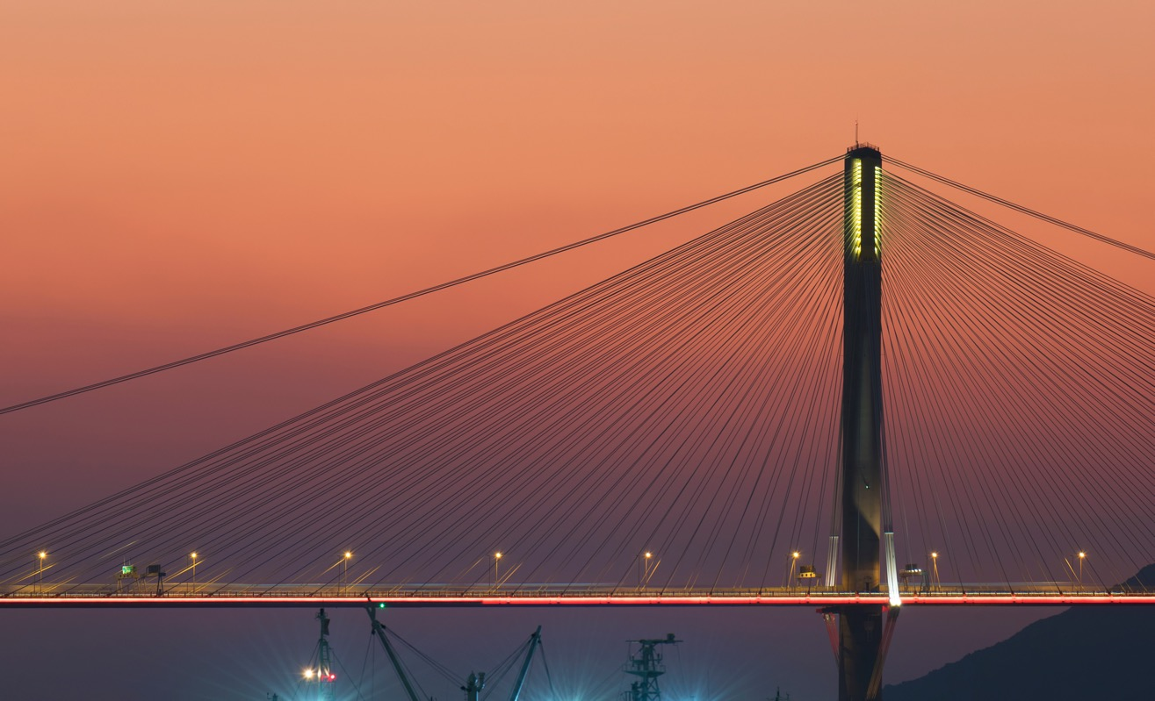
METROLOGY SOLUTIONS THAT EMPOWER YOU
We are experts in all cloud systems, instrumentation systems, software platforms, communication devices, and beautifully designed metrology products such as
Metrology Stands &
Power Systems
Data Analysis
Professional Services
Cloud Hosting

Slide 5












OUR CLIENTS

Slide 6

PRECISON. PERFORMANCE. PRODUCTIVITY.
We collaborate with our customers to design elegant metrology systems within a sustainable, ethical, transparent, and inclusive culture. We bring clarity to complicated problems
and strive to make the world a better place.

Slide 7

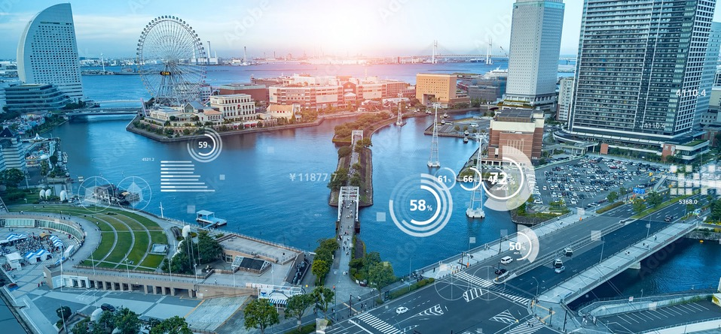
MEET THE TEAM
SHANE ROSS
Shane is President & CEO
of HAKARI and leads a team of hard-working metrology professionals committed to
best practices.

Slide 8




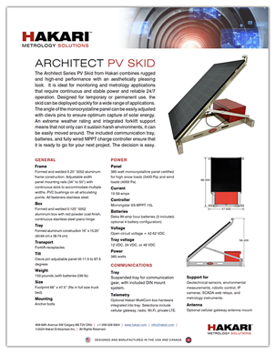
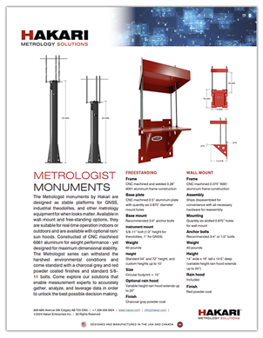
OUR PRODUCTS
Our mission is to build great products that empower you.
We are inspired by the people who use technology and vision to create change.
We give you the confidence to tackle any project.
HAKARI is always the right choice.
HAKARI™ designs and manufactures all products in the USA and Canada.

Slide 9

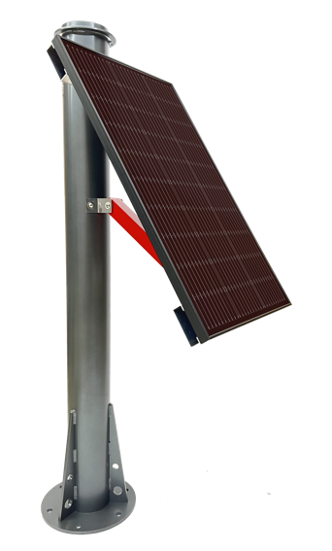
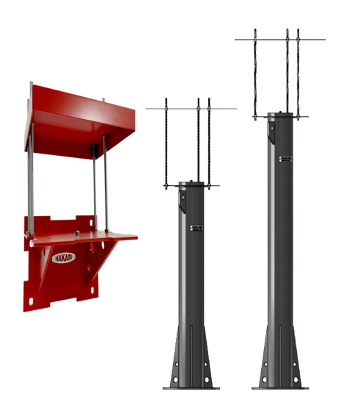
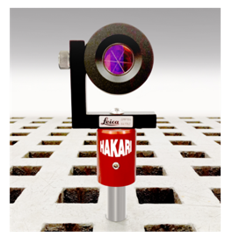
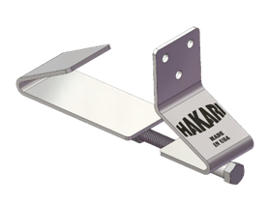
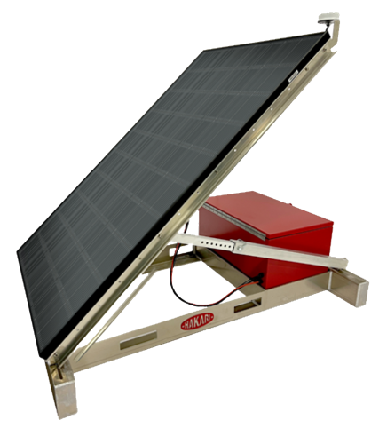
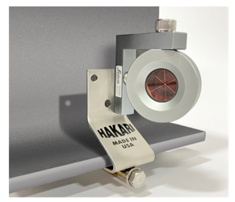
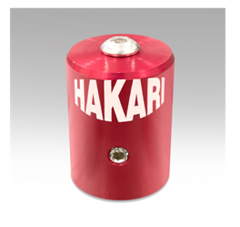
OUR PRODUCTS
SIDE OF POLE
RAIL CLIP
METROLOGY MONUMENTS
ROD CAP
PV SKID
HAKARI™ designs and manufactures all products in the USA and Canada.

Slide 10

OUR EXPERTISE
We design and manufacture our products to help our customers improve the monitoring of valuable assets and critical infrastructure, and to increase performance and productivity.
HAKARI is always the right choice.

Slide 11
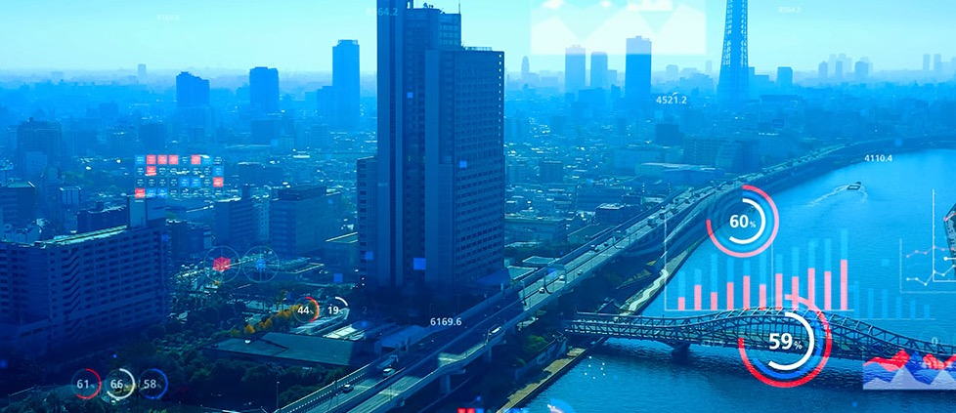
MONUMENTS & POWER SYSTEMS
HAKARI Metrologist monuments are designed as stable platforms for GNSS, industrial theodolites, and other metrology equipment.
Built to last and look great.
HAKARI is always the right choice.

Slide 12
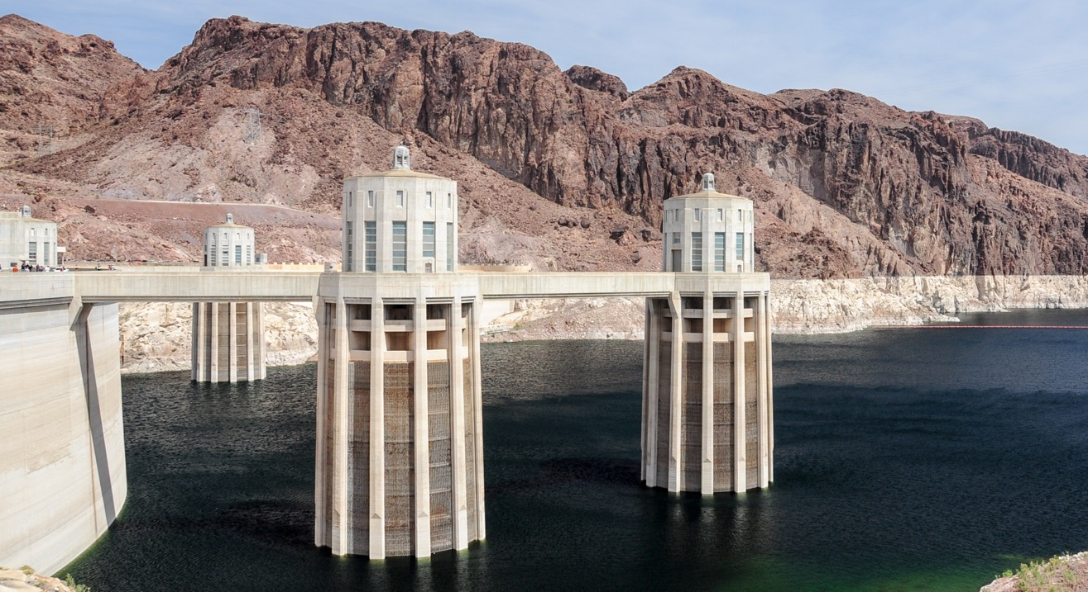
MONUMENTS & POWER SYSTEMS
HAKARI Architect power systems combine rugged and high-end performance with an aesthetically pleasing look.
Let us ensure that you are ready to go for your next project.
HAKARI is always the right choice.

Slide 13
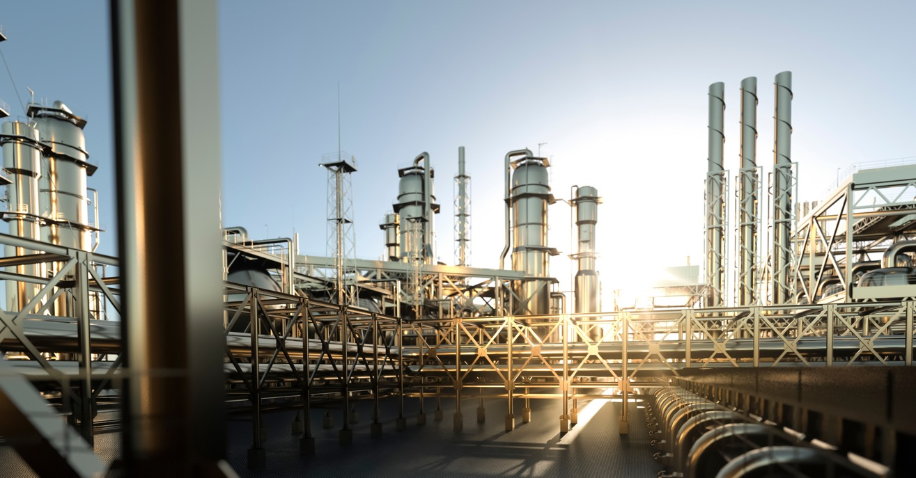
PROFESSIONAL SERVICES
The goal at HAKARI is for our customers to do well.
We provide design services, system integration, system rentals, and data analysis so that our clients are in a position to manage risk and make the world a safer, better place.

Slide 14

DATA ANALYSIS
We help you to connect complex data to insight
so you can see the correct path forward.
Monitoring a cooling tower with an optical system, or crunching numbers to evaluate the performance of a hydroelectric facility – HAKARI shows the way.

Slide 15

CLOUD HOSTING
Choose HAKARI to build and manage all your apps on secure cloud platforms with the design framework that you select.
HAKARI is always the right choice.

Slide 16
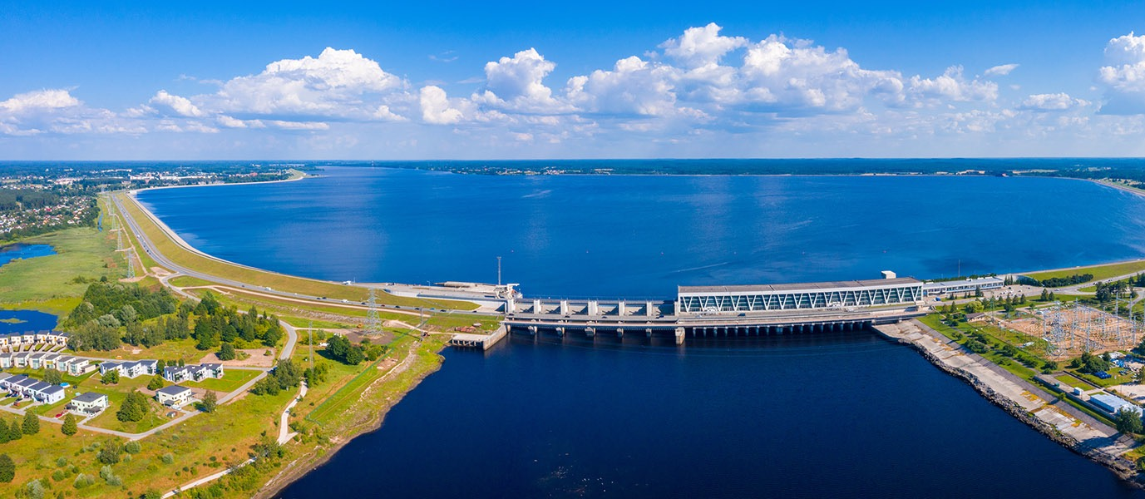
CLOUD HOSTING
HAKARI manages cloud resources for the most critical, sensitive and demanding projects.
The choice is easy and the data is always yours.
HAKARI is always the right choice.

Slide 17
809 - 68th Ave SW Calgary AB T2V 0N5 CANADA
info@hakari.com / www.hakari.com
©2024 Hakari Enterprises Inc. / All Rights Reserved. / HAKARI is a trademark of Hakari Enterprises Inc.

